Slide 1

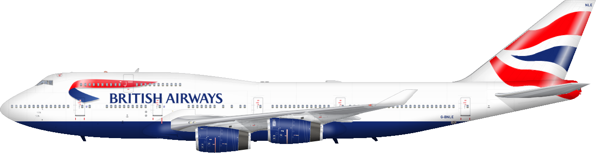

Raja Sekhar Rapaka

Slide 2

Introduction
British Airways (BA) is the flag carrier airline of the United Kingdom (UK). Every day, thousands of BA flights arrive to and depart from the UK, carrying customers across the world. Whether it’s for holidays, work or any other reason, the end-to-end process of scheduling, planning, boarding, fueling, transporting, landing, and continuously running flights on time, efficiently and with top-class customer service is a huge task with many highly important responsibilities.

Slide 3
Task - 1

Slide 4
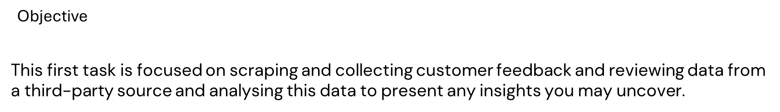
Problem Statement
As a data scientist at BA, it will be your job to apply your analytical skills to influence real life multi-million-pound decisions from day one, making a tangible impact on the business as your recommendations, tools and models drive key business decisions, reduce costs and increase revenue.
Customers who book a flight with BA will experience many interaction points with the BA brand. Understanding a customer's feelings, needs, and feedback is crucial for any business, including BA.
Scrape the data from : https://www.airlinequality.com/

Slide 5

Procedure
Scrape data from the web
Analyze data
Present insights

Slide 6
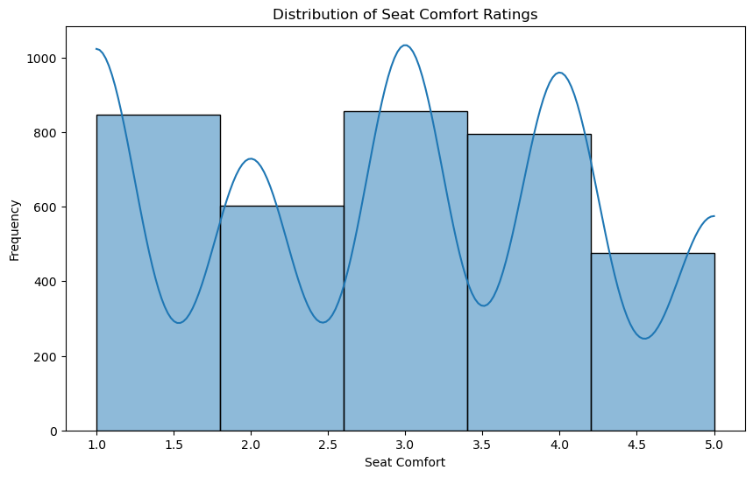
Most passengers find seats moderately comfortable with a slight skew towards higher comfort levels.

Slide 7
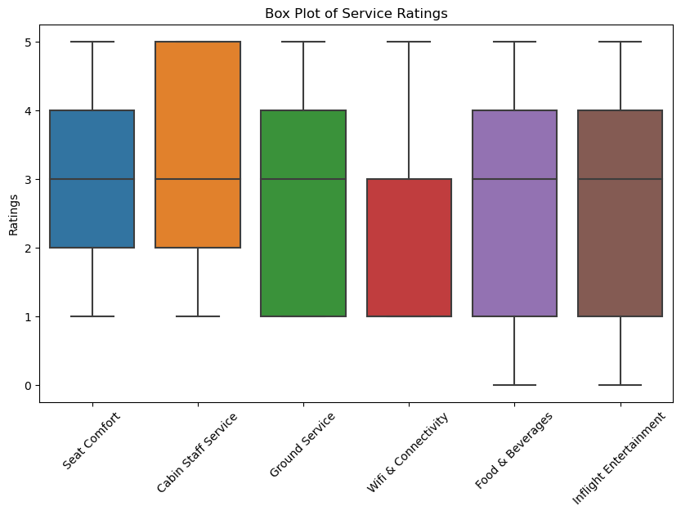
Cabin Staff Service received the highest ratings but also showed the greatest variation, Wifi & Connectivity had the lowest overall ratings and room for improvement.

Slide 8
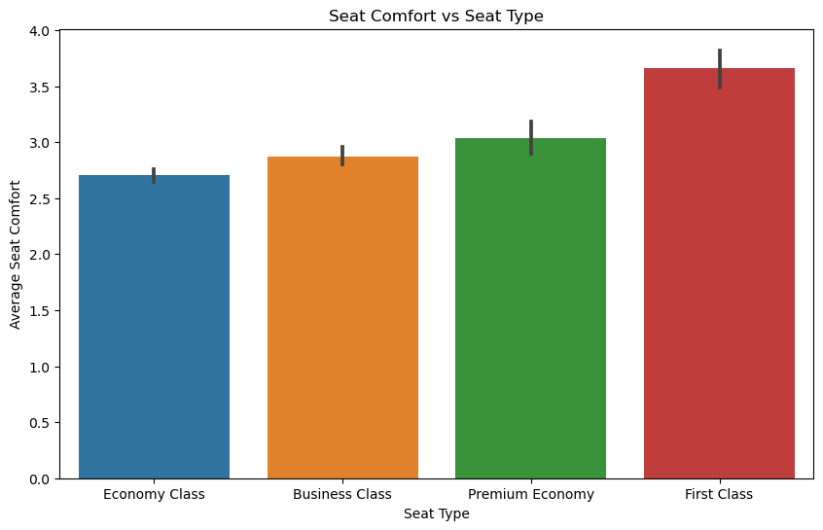
Seat comfort increases with seat class, with First Class having the highest average rating and Economy Class having the lowest. Error bars suggest variability in comfort ratings within each seat type.

Slide 9
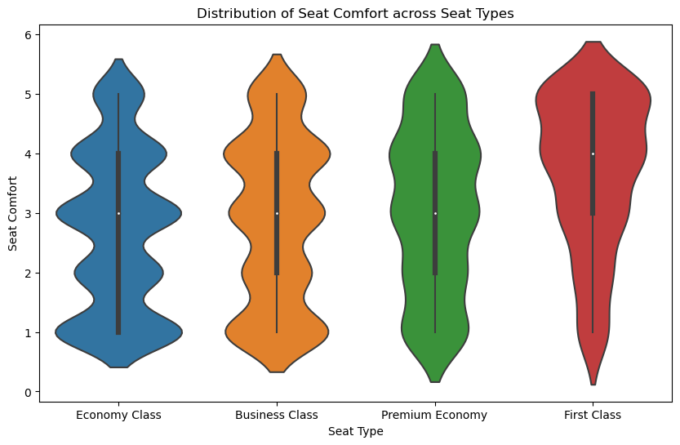
Seat comfort significantly increases from Economy Class to First Class, with wider distributions (more variability) in comfort ratings for lower seat classes.

Slide 10
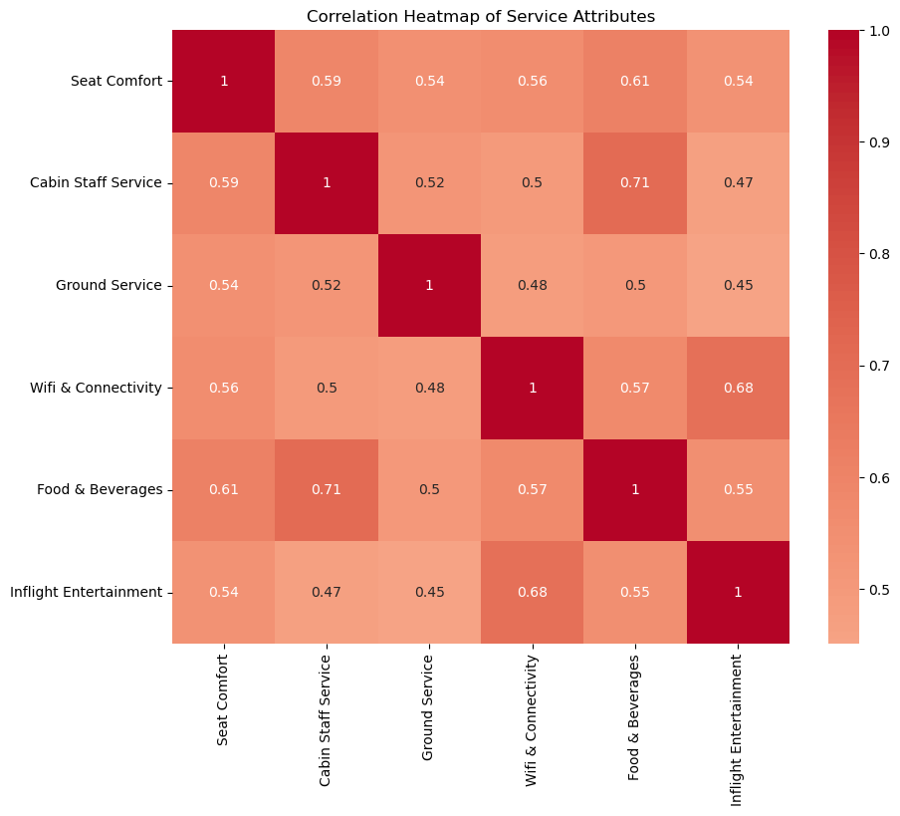
The correlation heatmap reveals strong positive relationships between most service attributes, with Cabin Staff Service and Food & Beverages demonstrating the highest correlations. Wifi & Connectivity has a notably lower correlation with other attributes.

Slide 11
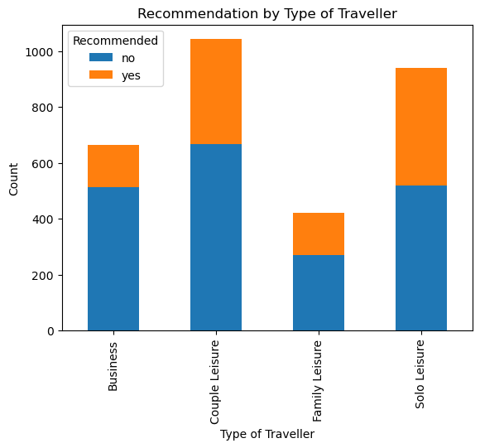
Couple and Solo Leisure travelers represent the largest segments, with Couples showing the highest rate of recommendations. However, Business travelers exhibit lower satisfaction levels, while Family Leisure travelers, despite being a smaller group, demonstrate a higher proportion of positive recommendations.

Slide 12
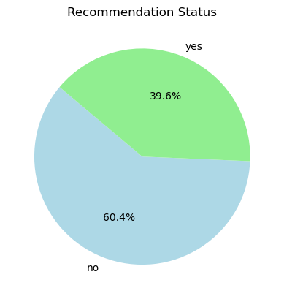
The pie chart shows the recommendation status, with 39.6% of respondents recommending and 60.4% not recommending. This indicates a higher proportion of respondents did not recommend the product or service.

Slide 13
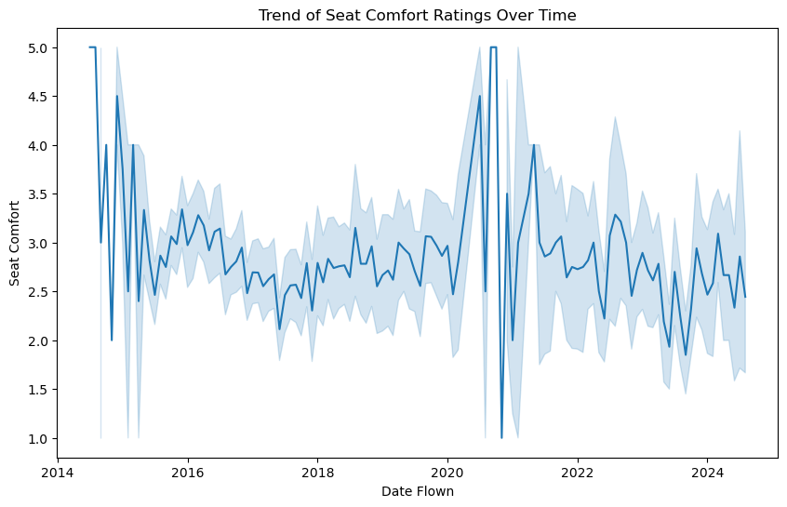
Seat comfort ratings exhibit significant fluctuations over time, with peaks and troughs occurring throughout the years. While there's a general upward trend, the year-to-year variability is substantial.

Slide 14
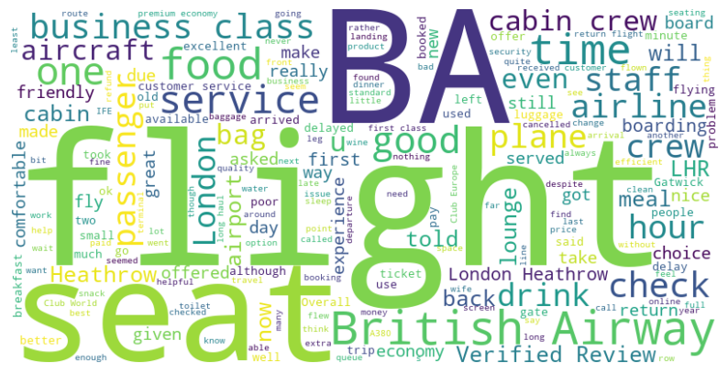
The word cloud highlights key aspects of British Airways' customer feedback, with frequent mentions of "flight," "seat," "service," and "business class," suggesting a focus on in-flight experience and comfort. Positive feedback centers around the crew and service, while operational concerns like "check," "boarding," and "delay" also appear prominently, especially at major hubs like Heathrow and Gatwick.

Slide 15
Task 2

Slide 16
Problem Statement
Customers are more empowered than ever because they have access to a wealth of information at their fingertips. This is one of the reasons the buying cycle is very different to what it used to be. Today, if you’re hoping that a customer purchases your flights or holidays as they come into the airport, you’ve already lost! Being reactive in this situation is not ideal, airlines must be proactive in order to acquire customers before they embark on their holiday.
This is possible with the use of data and predictive models. The most important factor with a predictive model is the quality of the data you use to train the machine learning algorithms. For this task, you must manipulate and prepare the provided customer booking data so that you can build a high-quality predictive model.
With your predictive model, it is important to interpret the results in order to understand how “predictive” the data really was and whether we can feasibly use it to predict the target outcome (customers buying holidays). Therefore, you should evaluate the model's performance and output how each variable contributes to the predictive model's power.
Objective
Using customer data and predictive models to help British Airways acquire customers before they embark on their holidays

Slide 17
Procedure
Explore and prepare the dataset
Train a machine learning model
Evaluate model and present findings

Slide 18

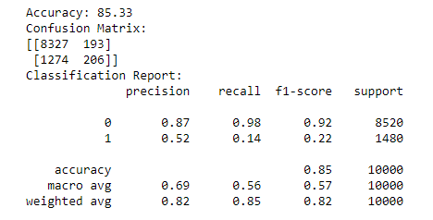
Random Forest Classifier

Slide 19
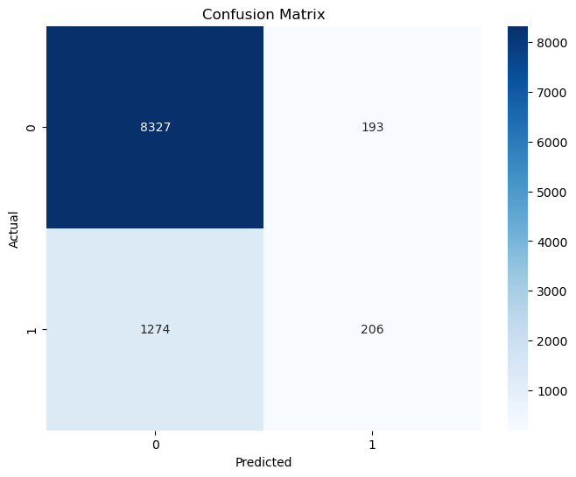
Confusion Matrix:
Accuracy in Negative Predictions: The model correctly identified 8,327 out of 8,520 negative instances, indicating strong performance in predicting the negative class.
High False Negative Rate: The model failed to correctly identify 1,274 out of 1,480 positive instances, which is concerning for applications where missing positive cases has significant consequences.

Slide 20
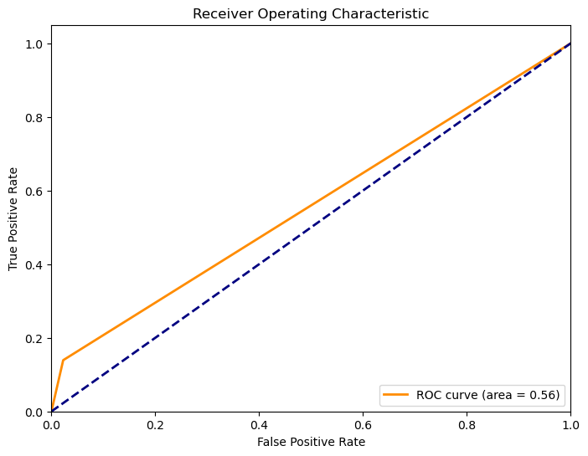
ROC Curve:
AUC of 0.56: The model's AUC value is just above 0.5, suggesting that it performs only slightly better than random guessing in distinguishing between positive and negative cases.
Limited Discrimination Ability: The curve is close to the diagonal line, indicating that the model has poor ability to discriminate between true positive and false positive rates.

Slide 21
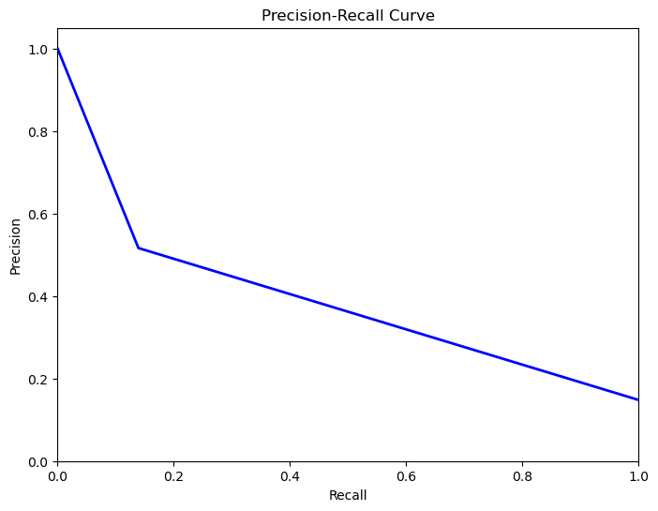
Precision-Recall Curve:
High Precision at Low Recall: The model is very precise when recall is low, meaning when it predicts a positive, it's usually correct, but it doesn't catch many positive cases.
Significant Drop in Precision with Higher Recall: As the model tries to increase recall (capture more positives), precision drops sharply, indicating a trade-off where more false positives are introduced.

Slide 22
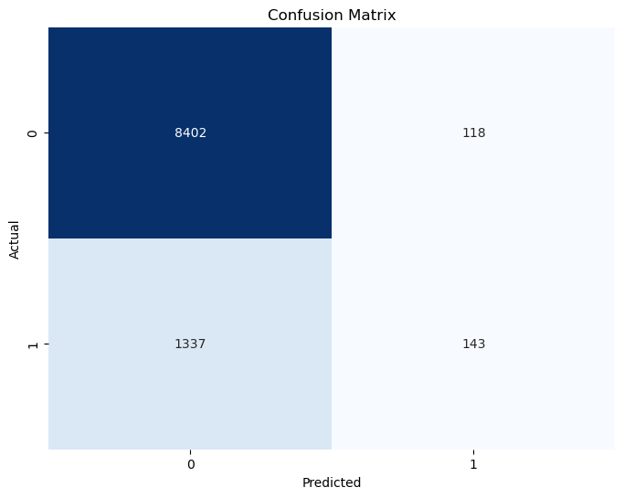
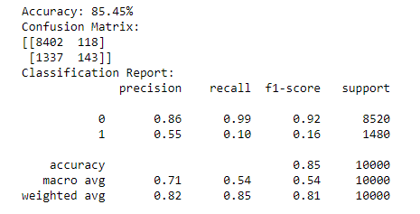
XG Boost Model
Confusion Matrix
Metrics

Slide 23

Conclusion
Route
Booking Origin
Flight Duration
Wants Extra Baggage
Length of Stay
are the top 5 features which influence Customer buying behavior
To solve the problem, I suggest to :
Provide attractive offers such as getting a higher discount if customer order before 30 days of flight.
Provide rescheduling options to customers with a maximum deadline of 3 days before the flight.

Slide 24
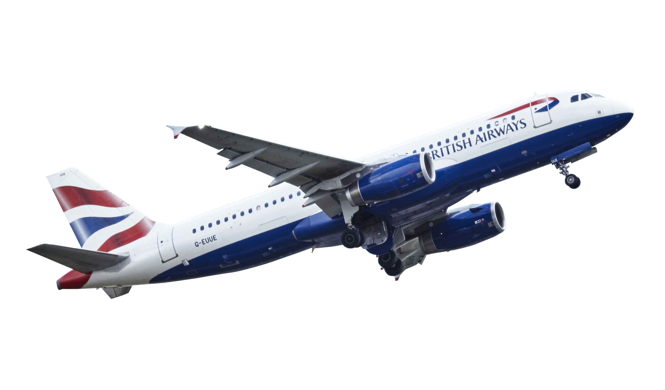
Thank You

